Slide 1
FPGA Implementation of In-Memory Search Macro with Range Encoding
Speaker : B11901027 王仁軒
Mentor : Rick Huang
Advisor: Prof. An-Yeu (Andy) Wu
Date : 2025/05/02

Slide 2
Outline
Introduction to few-shot learning
BORE range encoding scheme
IMS system architecture
Implementation on FPGA
Result
Embedding dimension reduction
Analysis of PCA (Principle Component Analysis)
Analysis of quantization method
Modification of AutoEncoder method

Slide 3
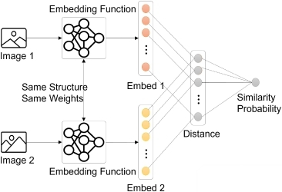
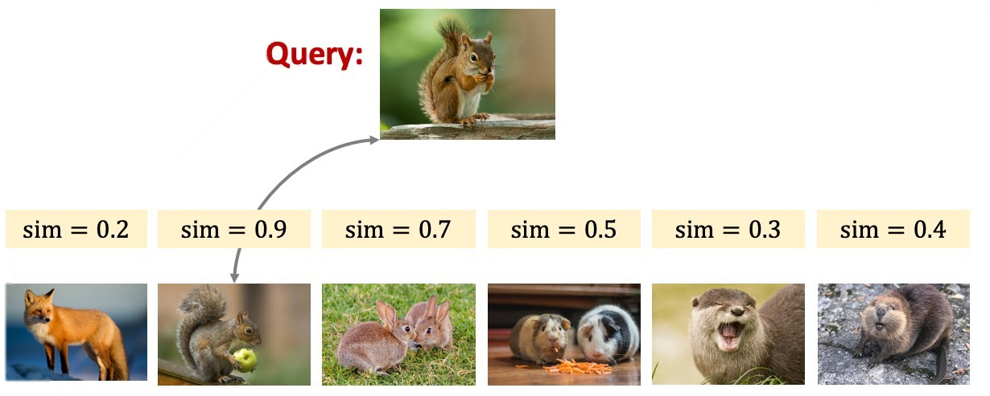
Few-Shot Learning
In few-shot learning, we compare similarity between query and supporting data in memory
Process data with NN, store embeddings into memory
Compute similarity between query and supporting embeddings
In memory

Slide 4
Similarity Search
Which class does query belong to?
Iterative vs one-shot method
Iteratively expand from query
Less space Long time
1
3
2
Overlap
query
Take advantages of both method
1
2
query
Create squares from existing data
More space Short time
1
query
Expand supporting data in advance
Iteratively expand query data

Slide 5
System Architecture
TOP
in
in
Word
Encoder
Mask data
Mask
Encoder
Encoder_en
Controller
Write_en
word
mask
Search_en
Buffer
Buffer
Buffer
Buffer
TCAM Bit-line Generator
M1
M2
M3
M4
M5
M6
M7
M8
Match
Post Processing Unit
Address

Slide 6
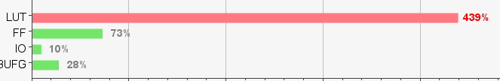
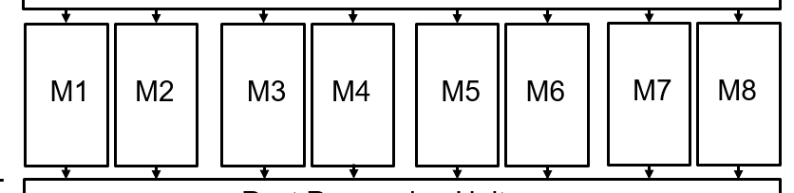
Direct Implementation
Some Issue happened when implementing on FPGA directly
Too complicated
FPGA board has limited ALU resources
Reduce the use of MEM
Fix the memory mapping method in this design

Slide 7
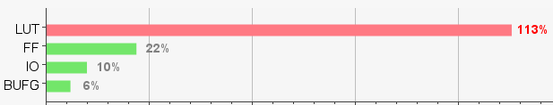
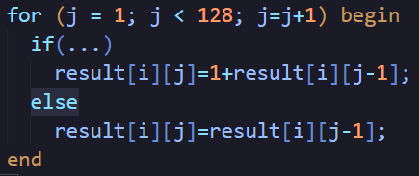
Direct Implementation
Some Issue happened when implementing on FPGA directly
After removing unnecessary blocks
Still not simple enough
Rewrite memory macro
+
+
+
+
Smaller
Faster
+
+
+
x128
Large 3D array
+
Adder Tree

Slide 8
Revised System Architecture
TOP
in
in
Word
Encoder
Mask data
Mask
Encoder
Encoder_en
Controller
Write_en
word
Search_en
mask
Buffer
TCAM Bit-line Generator
M1
M2
Match
Post Processing Unit
Address

Slide 9

Input Stimuli Generation
Input stimuli were provided by testbench $→$ Non-synthesizable
Rewrite testbench into a synthesizable module
Using RAM on FPGA board to preload data
Support Data RAM
addr
TB
data
FSM
in
Encoder_en
TOP
Query Data RAM
addr
Input
Gen.
Write_en
data
Search_en
Golden
Data RAM
addr
Result
Checker
Match
Address
data
LED

Slide 10
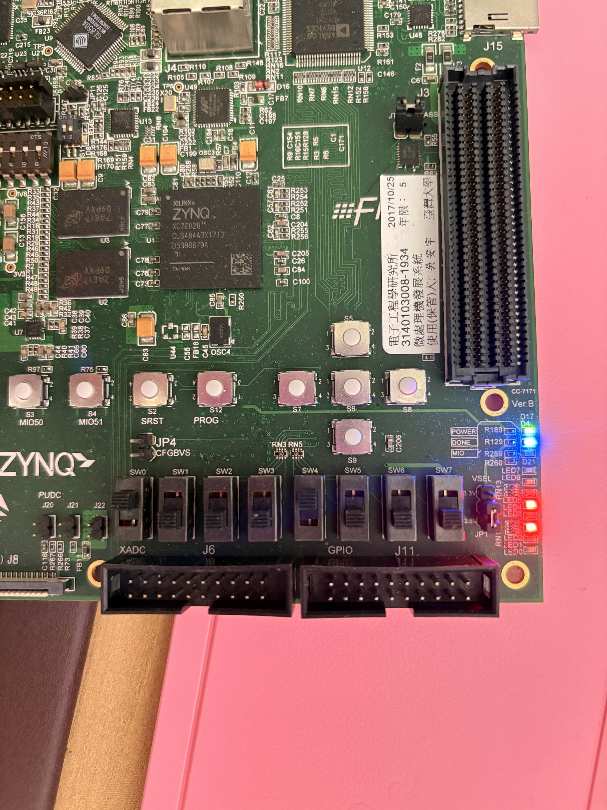
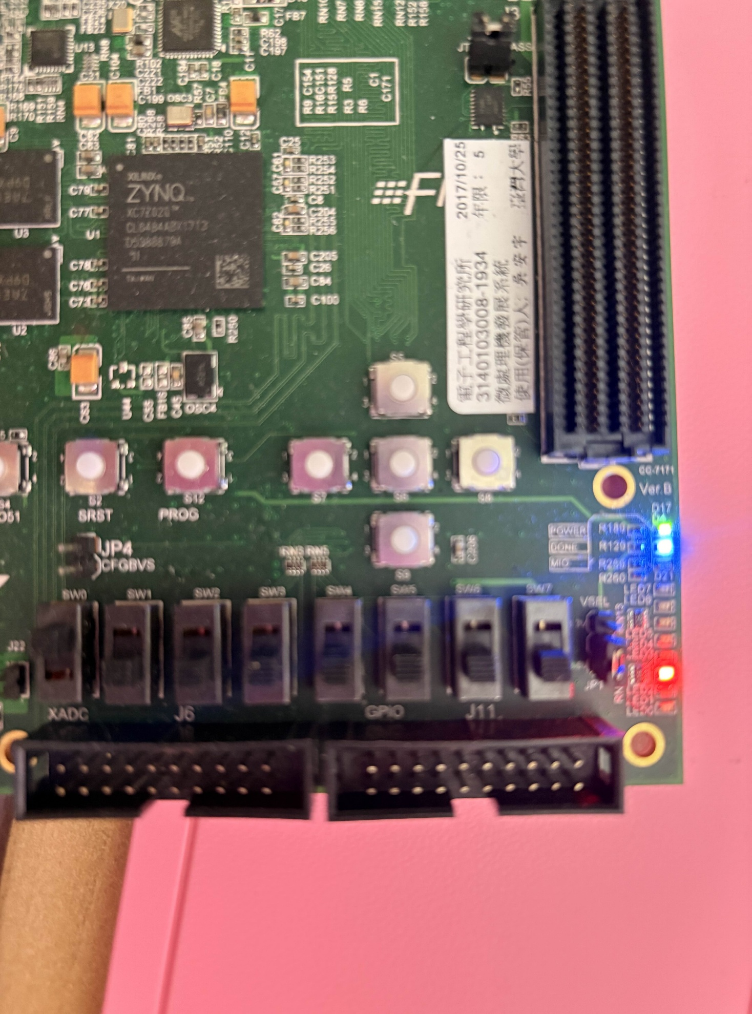
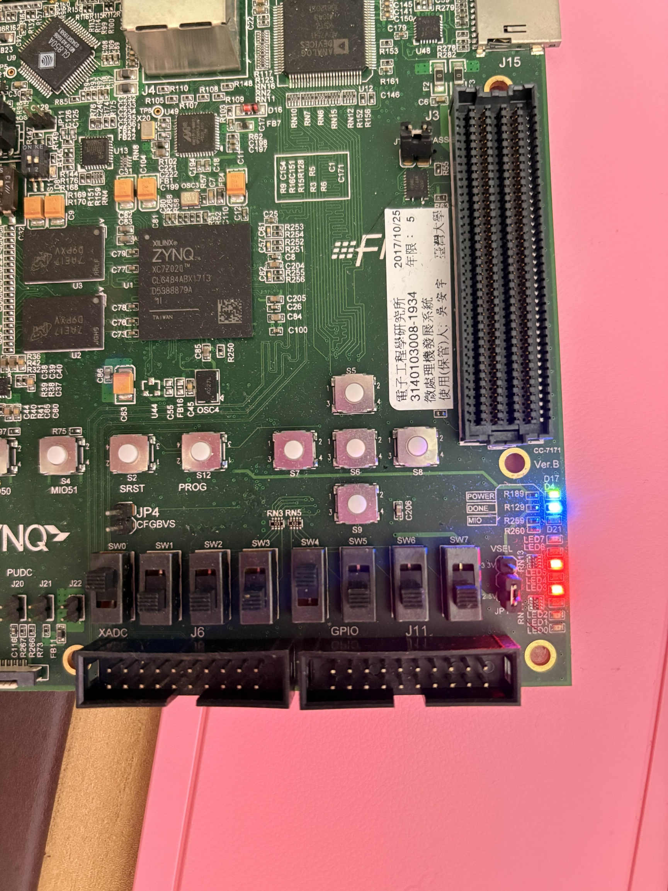
Result
After start signal is sent, TB receives MATCH signal from TOP once Search SW is triggered (active low)
LED shows the ADDRESS signal
LED Config
Address
Finish
Search
Search
Search
Address = (1010)2=10
Address = (10)2=2
Address = (10100)2=20

Slide 11
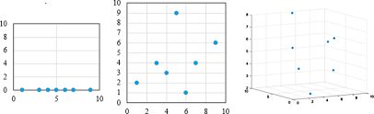
Curse of Dimensionality
As dimensions increases, data become increasingly sparce, causing traditional algorithms to struggle
The number of dimensions should meet the HW provided by MXIC
64-dimensional INT3 L2-norm search
Input
64D
Input
64D
Input
64D
IMS Macro
IMS Macro
IMS Macro
……

Slide 12
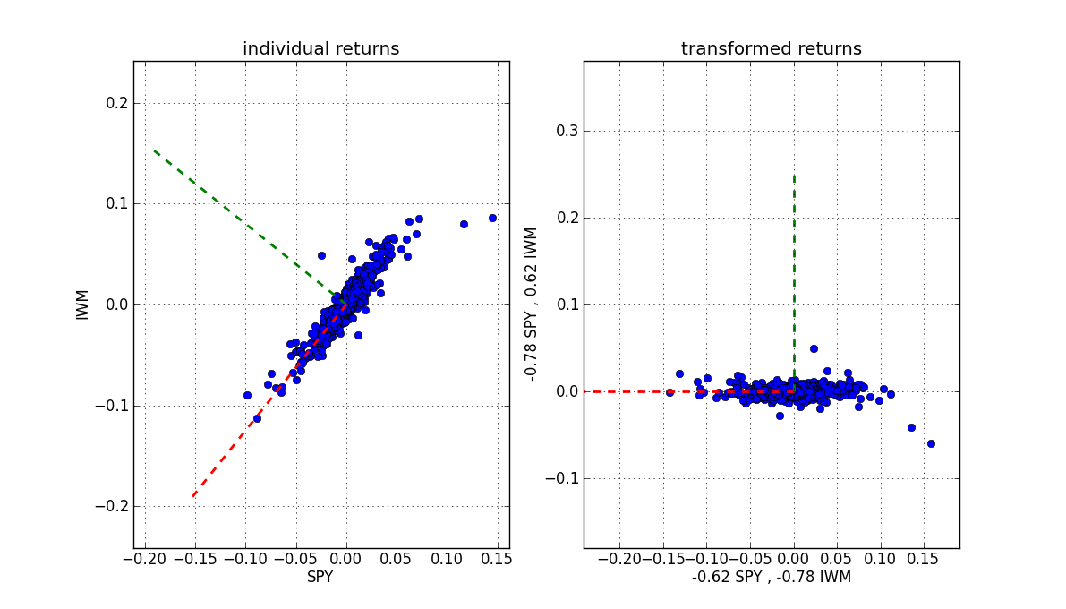
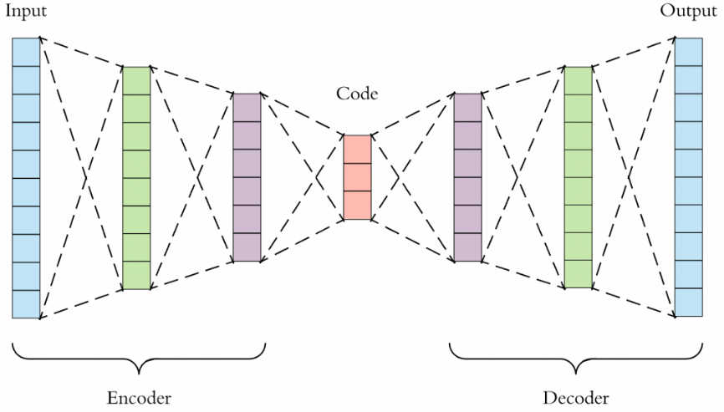
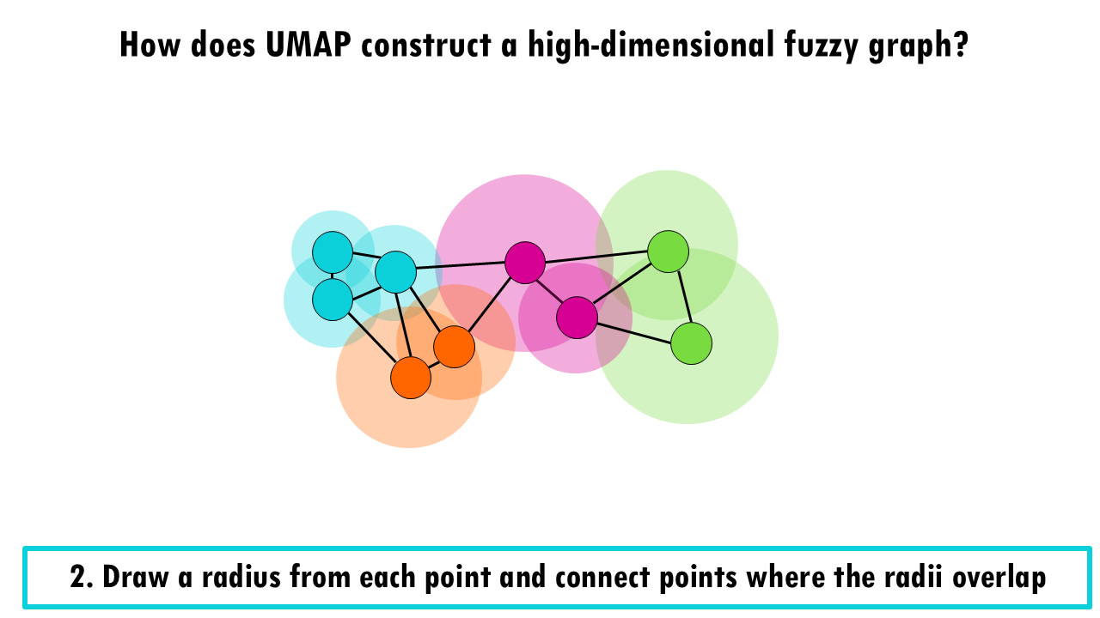
Methods of Dimension Reduction
3
3
Linear
Pooling
Average Pooling
Magnitude Pooling
Principle Component Analysis
Non-Linear
UMAP
Autoencoder (AE)
1
1
9
2
9
3
5
77
5
97
4
3
4
4
2
4
2
8
8
8
0
0
Average Pooling
Magnitude Pooling
PCA
UMAP
Closer points -> exponential decay to maintain local distance
Farther points -> inverse-polynomial to maintain global distance
Autoencoder

Slide 13
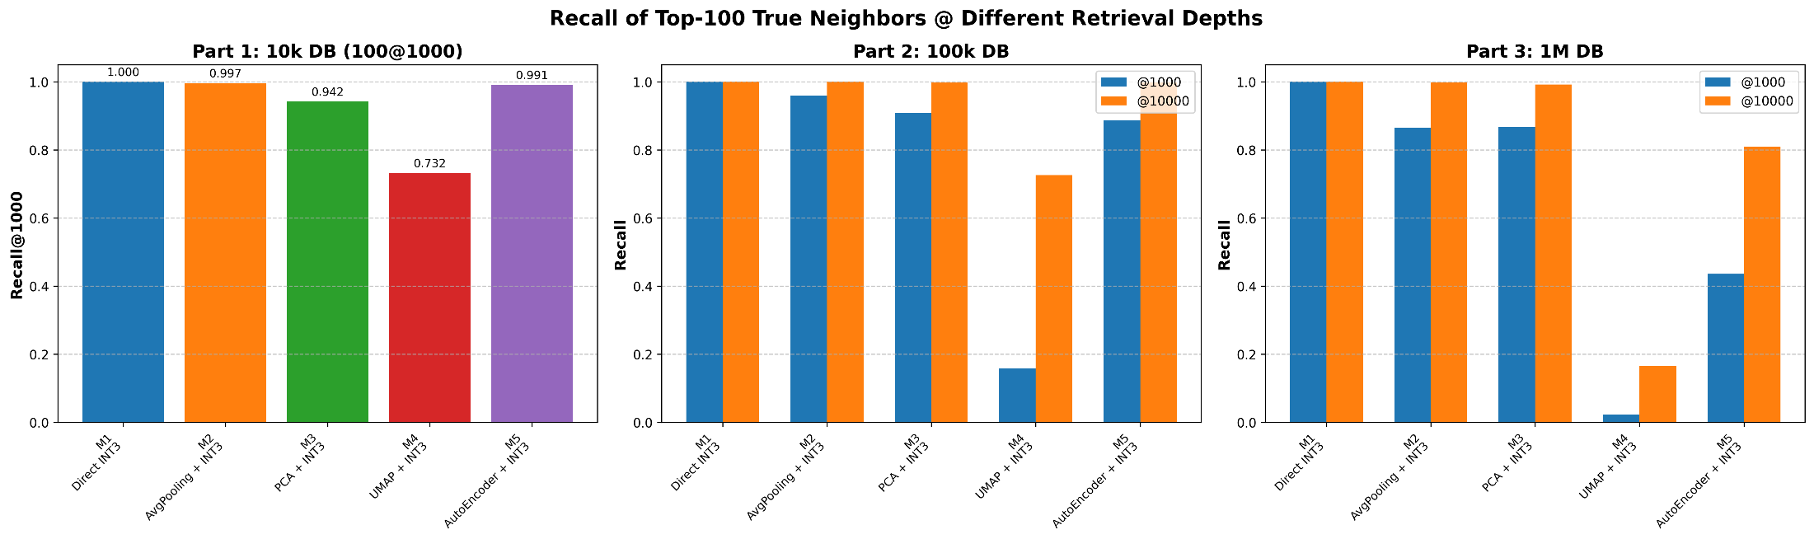
Experimental Results (SIFT-1M)
Using SIFT-1M dataset
Vector dimension: 128 -> 64
Quantization method: min-max quantization
Avg. Pooling > PCA >= AE > UMAP

Slide 14
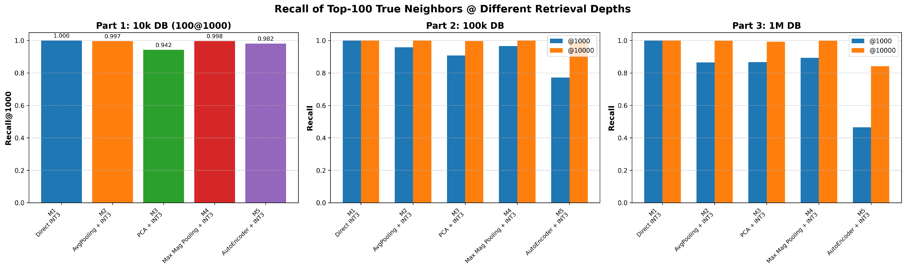
Experimental Results (SIFT-1M)
Using SIFT-1M dataset
Vector dimension: 128 -> 64
Quantization method: min-max quantization
Since the performance of UMAP is worst, it is replaced by magnitude pooling
Avg. Pooling = Mag. Pooling >= PCA >= AE

Slide 15
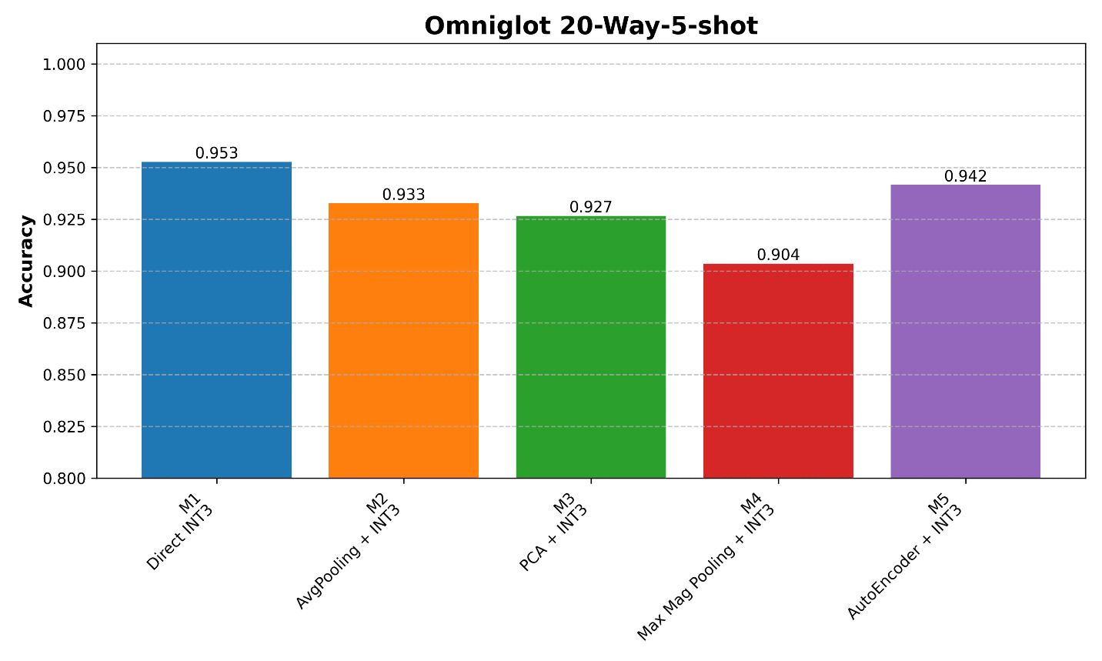
Experimental Results (Omniglot)
Using Omniglot 20-way-5-shot experiment
Embedding dimension: 128 -> 64
Quantization method: min-max quantization
AE = Avg. Pooling = PCA >= Mag. Pooling

Slide 16
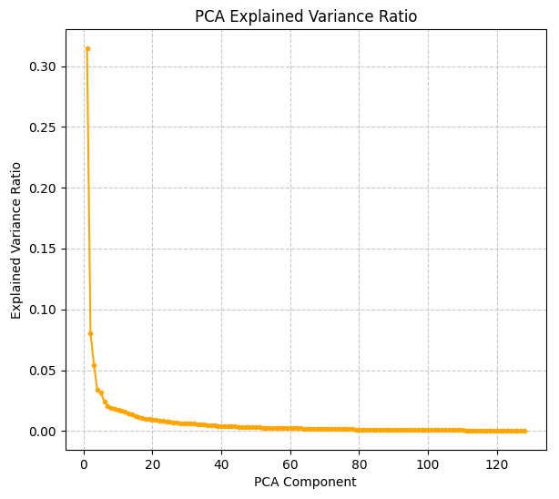
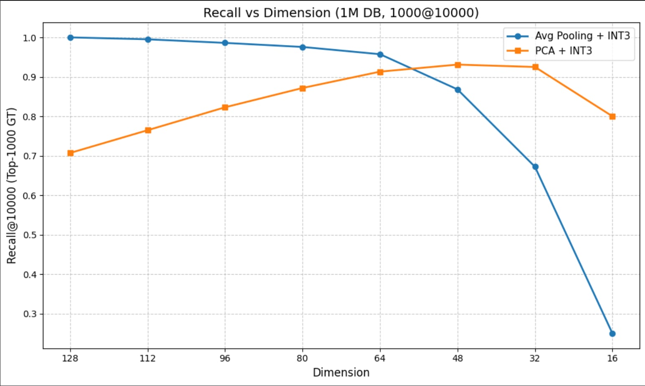
Analysis of PCA
PCA seems cannot win against average pooling
Is this true for all dimensions?
Why PCA achieves better recall rate when dim < 60
Too much noise from less representative dimensions
Low explained var. from dim 60 to 128

Slide 17
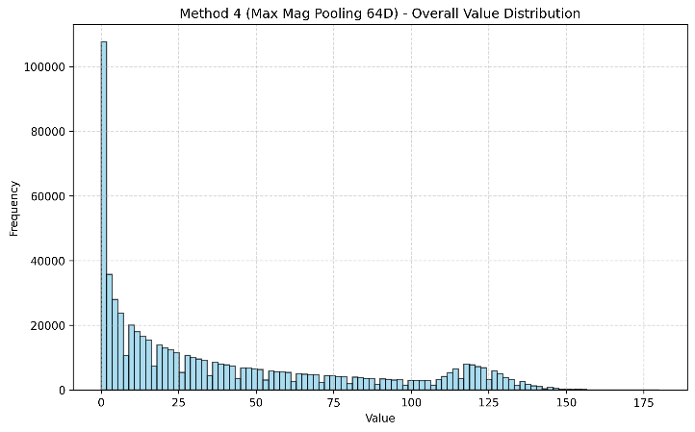
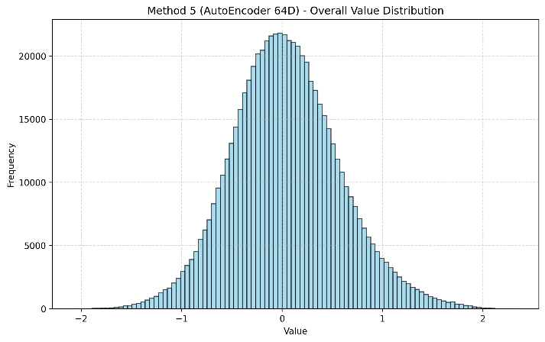
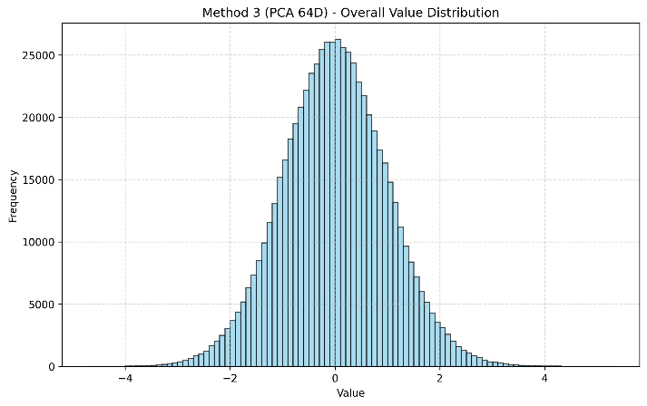
Data Distribution under Different Methods
What does the distributions look like after different dimension reduction methods
Some methods produces long-tail distributions
Others produces produces bell-shaped distributions
Can our quantization method fit all of these distributions?
Pooling
PCA
AutoEncoder

Slide 18
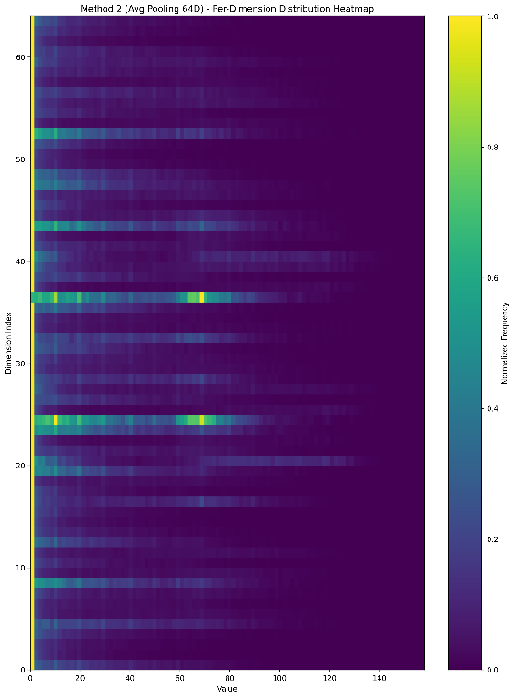
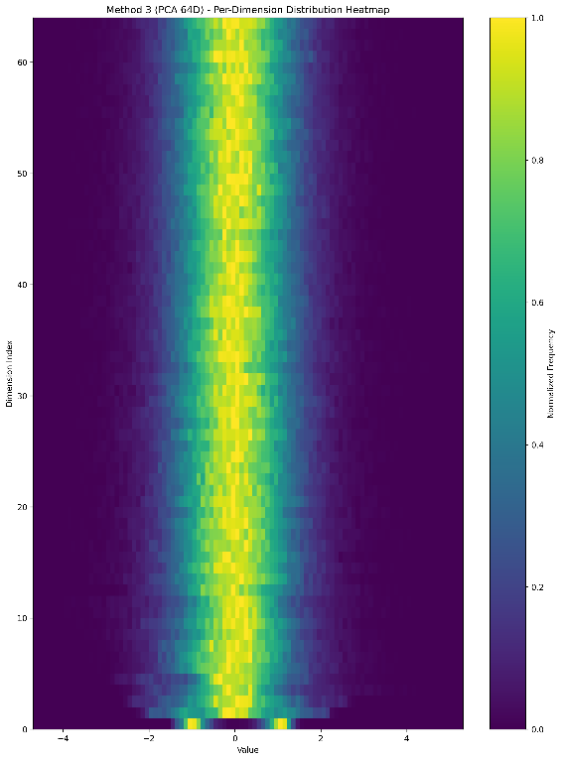
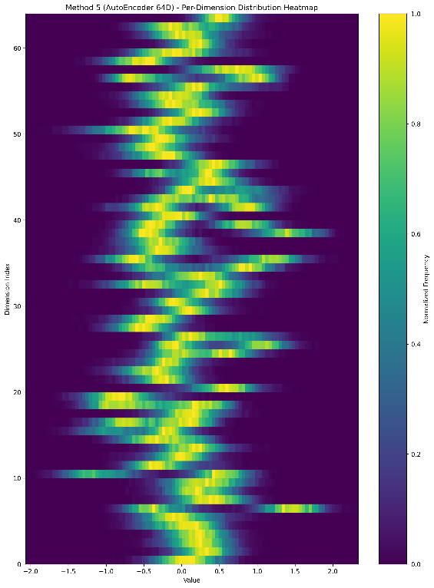
Data Distribution under Different Methods
What does the distributions look like after different dimension reduction methods
Some methods produces long-tail distributions
Others produces produces bell-shaped distributions
Can our quantization method fit all of these distributions?
Pooling
PCA
AutoEncoder

Slide 19
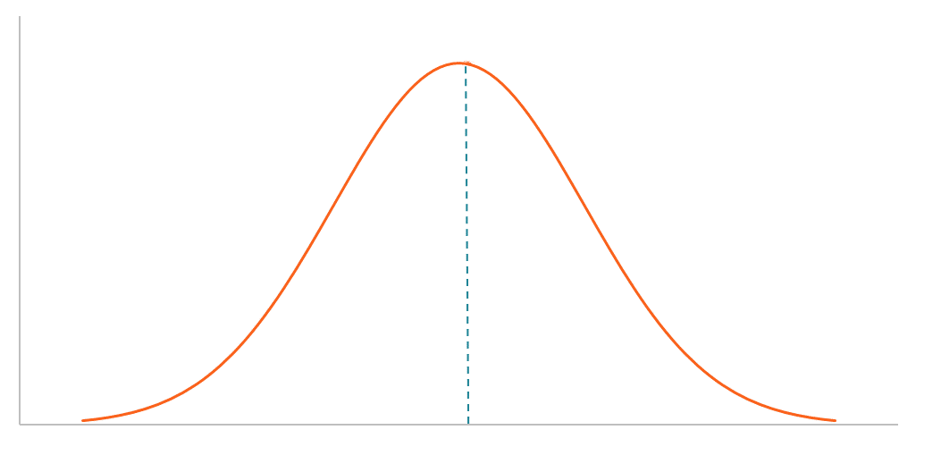
Quantization Makes Big Differences
New quantization method : Percentile Quantization
Quantize data according to its percentile among all data
Non-linear quantization
Better to distinguish top-k nearest neighbors
17%
33%
33%
17%
25%
25%
25%
25%
Min-max quantization
Percentile quantization

Slide 20
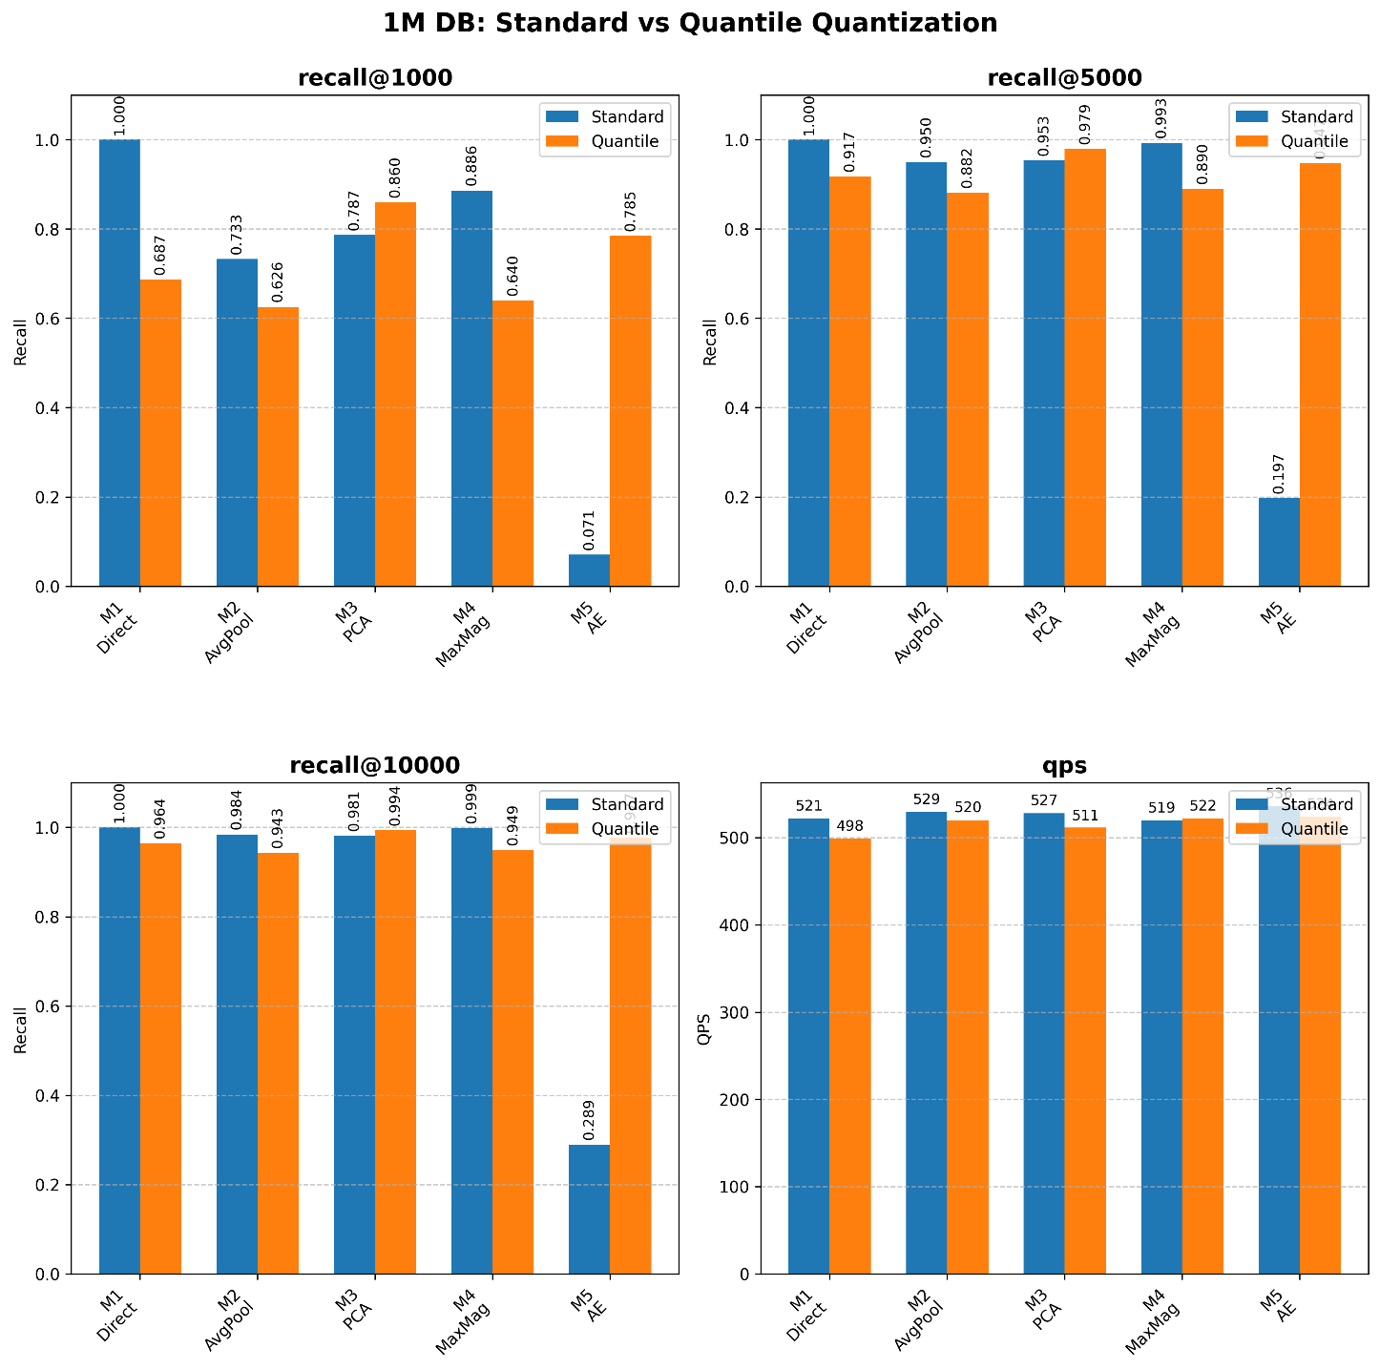

Experimental Results
Percentile quantization boosts the recall rate of AutoEncoder method
Embedding dimension: 128 -> 64
Blue: Min-max Quantization. Orange: Percentile Quantization
Min-max -> better for long-tail distribution
Percentile -> better for bell-shaped distribution

Slide 21
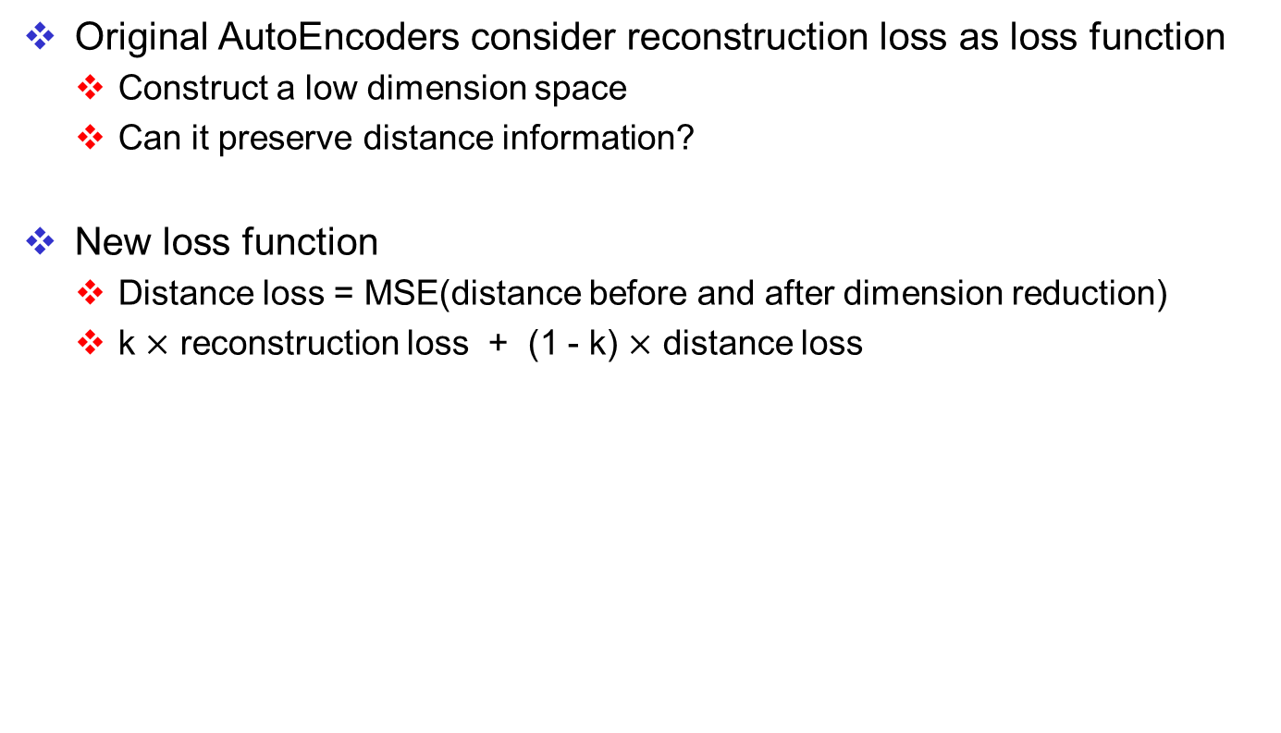
Modification of AutoEncoder
Original AutoEncoders consider reconstruction loss as loss function
Construct a low dimension space
Can it preserve distance information?
New loss function
Distance loss = MSE(distance before and after dimension reduction)
k $×$ reconstruction loss + (1 - k) $×$ distance loss
Reconstruction loss
Distance loss

Slide 22
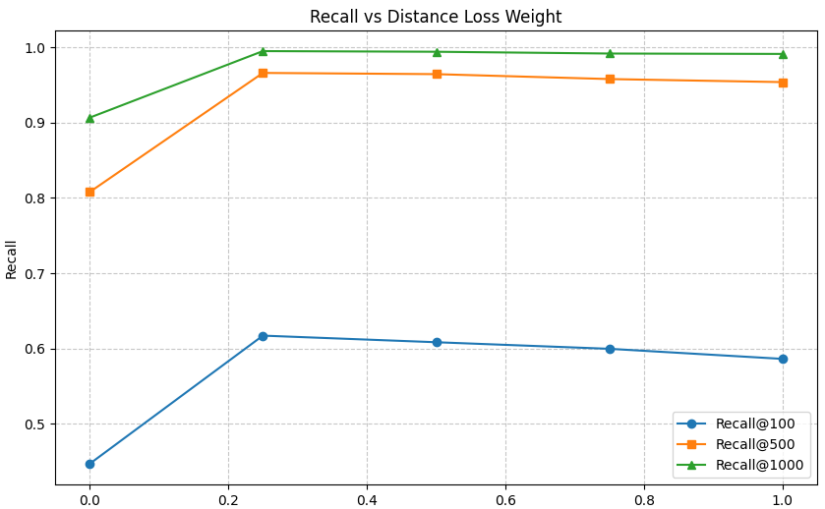
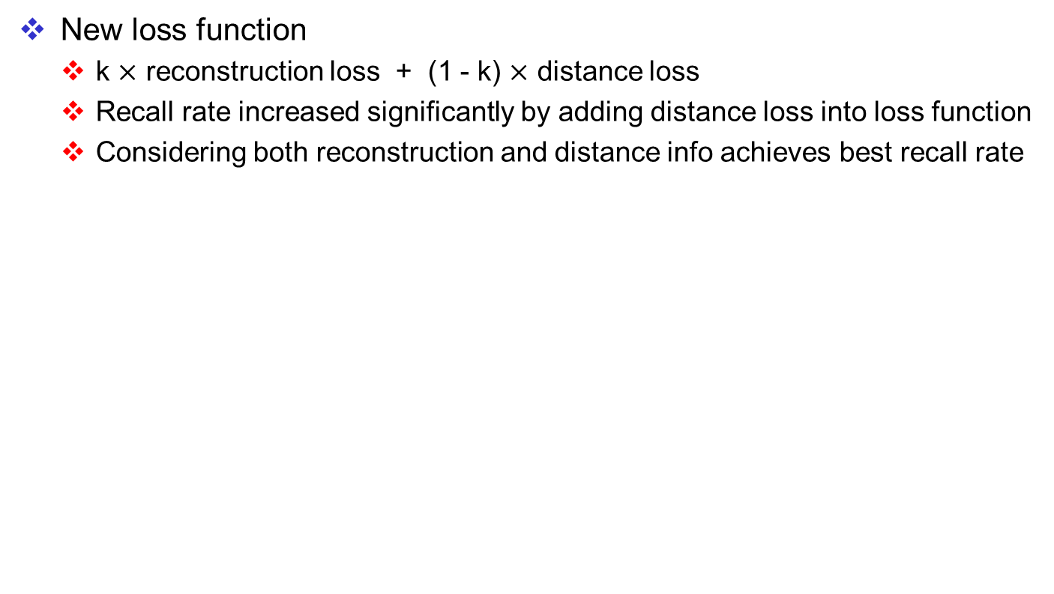
Experimental Results
New loss function
k $×$ reconstruction loss + (1 - k) $×$ distance loss
Recall rate increased significantly by adding distance loss into loss function
Considering both reconstruction and distance info achieves best recall rate
Best
k

Slide 23
Conclusion
Embedding dimension reduction
Average pooling is simple but effective
Analysis of PCA (Principle Component Analysis)
PCA outperforms average pooling when dimensions < 60
Analysis of quantization method
Min-max quantization is better for pooling methods
Quantile is better for PCA and AutoEncoders
Modification of AutoEncoder method
Preserving distance information increases recall rate
Best recall @ reconstruction : distance = 3 : 1

